Slide 1


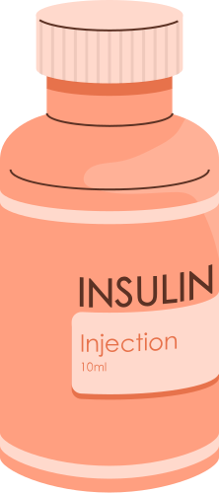
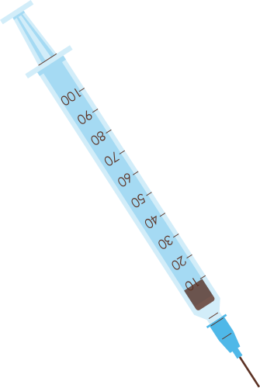


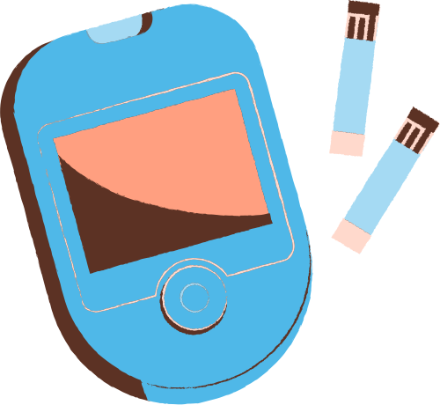
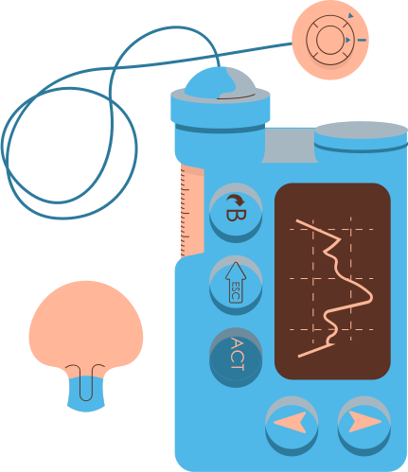
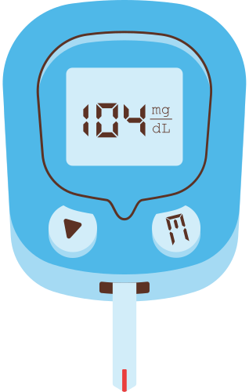

MULTI-DISEASE PROGNOSIS
~Rohit Kumar Kain

Slide 2

UNRAVELLING THE FUTURE OF DISEASE PREDICTION
Utilizes machine learning for predictive analysis of diabetes, heart diseases, and Parkinson's.
Targets global health challenges by enhancing early detection for improved management.
Leverages machine learning's transformative potential in healthcare.
Emphasizes the project's comprehensive impact on public health through the collective prediction of multiple diseases.

Slide 3
PROJECT INSPIRATION
Global Health Impact: Recognizing the increasing prevalence of diabetes, heart diseases, and Parkinson's on a global scale.
Personal Connection: Perhaps having a personal or familial connection to these diseases sparked a desire to contribute to their early detection and management.
Technological Advancements: The awareness of machine learning's transformative potential in healthcare likely influenced the decision to apply it for predictive analysis.
Healthcare Challenges: Identifying challenges in current disease detection methods and envisioning a more proactive and accurate approach.

Slide 4


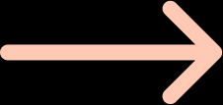
PROJECT OBJECTIVES

Slide 5
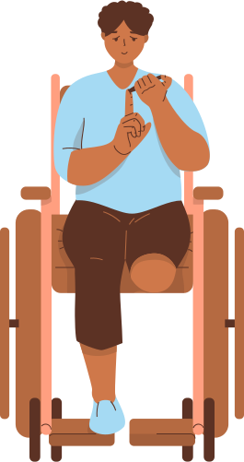
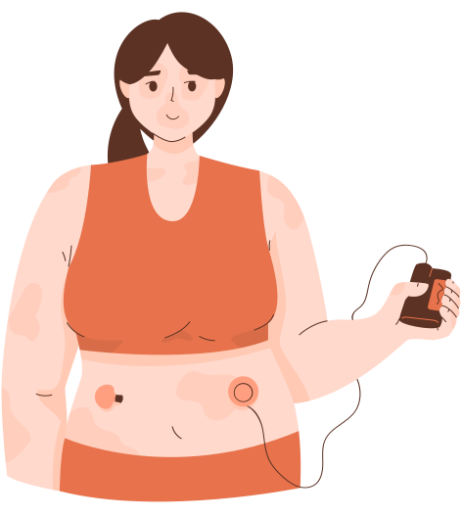
Develop Accurate Prediction Models
Early Detection
Improve Healthcare Outcomes
Feature Importance Analysis
Cross-Disease Comparison

Slide 6
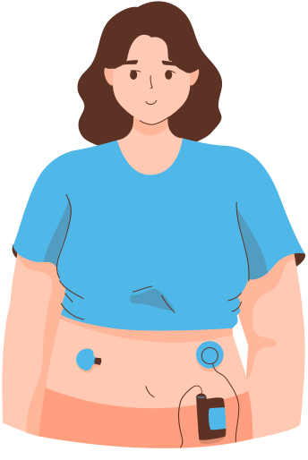
METHODOLOGY: A HOLISTIC APPROACH TO DEVELOPMENT

Slide 7
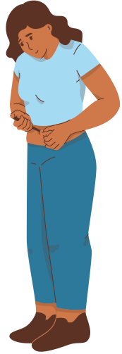
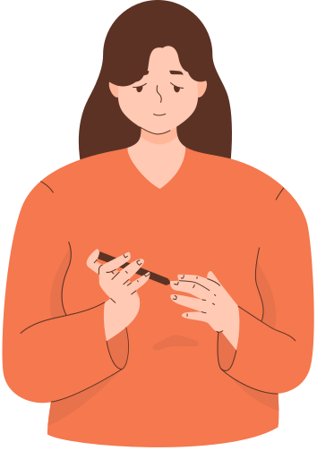
Data Collection
Data
Preprocessing
Feature
Selection
Machine Learning Models
Training Process
Hyperparameter Tuning

Slide 8
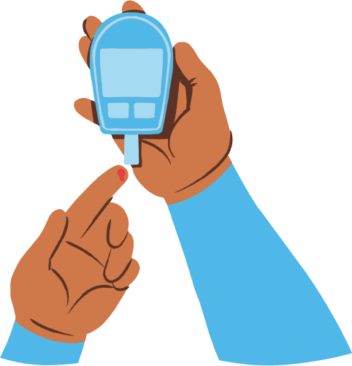
TOOLS AND TECHNOLOGY
Programming Language: Python for the recommendation algorithm and web application development.
Machine Learning Framework: Scikit-learn
Web Framework: Streamlit
Web Hosting/Deployment: HuggingFace
IDE (Integrated Development Environment): PyCharm, Visual Studio Code, or Jupyter Notebook for development.
Data Processing: Pandas and NumPy for data manipulation and preprocessing.

Slide 9

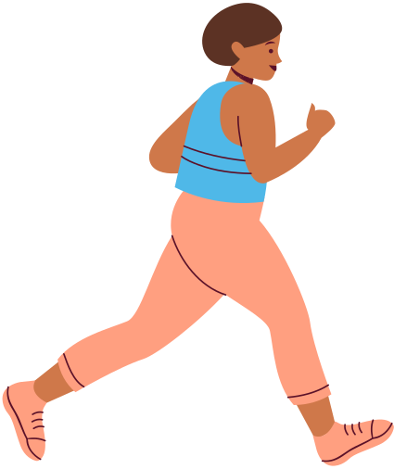
EXPECTED OUTCOMES: BENEFITS AND SCOPE
Accurate Disease Prediction
Early Intervention Opportunities
Enhanced Healthcare Strategies
Improved Patient Care
Identify Key Predictive Features

Slide 10
THANK YOU!
Thank you all for your time and engagement during the disease prediction presentation. Your thoughtful presence and insightful questions were truly appreciated. Grateful for your support.

Slide 11
GET IN TOUCH
WEBSITE:
hf.co/spaces/Rohit-Kain
EMAIL ADDRESS:
rohitkain09@gmail.com
SOCIAL MEDIA:
@the_rohit_kain
CONTACT NUMBER:
8851252709

